Slide 1


Asia-Pacific Financial Forum (APFF)
Insurers’ Long-Term Investments to Support Sustainable Growth and Development
Makoto Okubo, Nippon Life Insurance Company
Sherpa, APFF Insurance and Retirement Income Work Stream
Sherpa, APFF Retirement and Long-Term Investment Working Group
Shanghai, 21 September 2017

Slide 2
2
What is APFF?
APFF is a regional platform for collaboration among public sector, private sector and multilateral institutions to help accelerate the development and integration of financial markets and services in the APEC region.
APFF is an official policy initiative under the APEC Finance Ministers’ Process. It has been tasked to support the implementation of the Ministers’ Cebu Action Plan (a 10-year roadmap for the development and integration of financial markets in the region).
The management of APFF has been entrusted by the Finance Ministers to the private sector through the APEC Business Advisory Council (ABAC), which reports its progress to APEC senior finance officials and ministers regularly throughout the year.

Slide 3



3
The APFF Network
Firms
International / domestic industry associations
Investment / commercial banks
Insurers and pension funds
Non-bank lenders
Asset managers
Law, accounting, consultancy firms
Corporates
Credit rating agencies
Credit bureaus
Government agencies
Regulatory bodies
Finance ministries
Justice ministries
Trade ministries
Development assistance agencies
Foreign affairs ministries
International organizations
Academic / research institutions
ADB
BIS
IMF
OECD
World Bank/IFC
UNCITRAL
Securities industry
Banking (general, trade finance, secured lending, factoring)
Insurance and Pensions
Asset management
Business and consumer credit information
Chambers of commerce
Central banks
Securities, banking, insurance regulators
International regulatory organizations
Over 150 organizations
Over 300 individual experts

Slide 4
A Ten-Year Roadmap for the APEC Finance Ministers’ Process
FOUR PILLARS
4
The Cebu Action Plan (CAP)
FINANCIAL INTEGRATION
FISCAL TRANSPARENCY
Fiscal reforms
FINANCIAL RESILIENCE
Macroeconomic policy
INFRAST5RUCTURE
Knowledge portal
Financing MSMEs
Financial inclusion and literacy
Facilitating remittances
Financial services liberalization
Capital accounts liberalization
Asia Region Funds Passport
Open Data Initiative
Exchange of financial account information
Base erosion profit shifting
Tax and crime
Disaster risk financing and insurance
Capital market development
Standardization of terms and practices
Maximizing PPPs in infrastructure investment
Long-term investors
Urban development
Regional connectivity

Slide 5

5
The APFF Structure
APEC Finance Ministers Process (FMP)
APEC Business Advisory Council (ABAC)
Asia-Pacific
Financial Forum
(APFF)
APFF Work Streams
Financial Infrastructure Development Network
Trade / Supply Chain Finance
Capital Markets
Financial Market Infrastructure / Cross-Border Practices
Insurance / Retirement Income
Linkages / Structural Issues
Credit Information
Classic repo markets
Retirement /Long-Term Investment
Secured Transactions
Derivatives
Disaster Risk Financing /Insurance
Accounts Receivables Finance
Asia Region Funds Passport
Microinsurance
Disaster Risk Financing

Slide 6
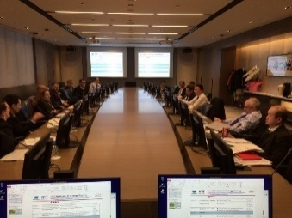
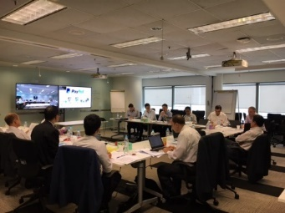
6
Scope of Work
Expanding MSMEs’ access to finance
Creating deep, liquid and integrated capital markets
Expanding the region’s long-term investor base
  Retirement income and long-term investment
  Islamic Infrastructure Investment Platform (I3P)
Fostering financially resilient communities
  Roadmap for expanding the coverage of micro-insurance in APEC
  Disaster risk finance and insurance
Dialogue and research on the future of financial regulation
Strategy Session
January 2017
Activities
Jan-July 2017
Drafting Session
July 2017
Continuation
to 2018

Slide 7
7
APFF work on retirement and long-term investment
2017 APFF Progress Report to APEC Finance Ministers
Expanding the Region’s Long-Term Investor Base
Triple wins thru Retirement income and long-term investment
  Consumers receive high and stable returns for long-term savings
  The financial sector is able to access deeper capital markets for infrastructure investment.
  Governments obtain relief from large contingent fiscal liabilities
Triple gaps to address to achieve the above objective
  Pension/Protection Gap
  Infrastructure/Investment Gap
  Regulatory/Accounting Gap

Slide 8
8
Pension/Protection Gap
Mandatory provisions and scalable retirements systems
Tax incentives to promote long-term saving products
Product/distribution innovation and financial awareness

Slide 9
9
Infrastructure/investment Gap
Promotion of infrastructure as a defined asset class
Increased fiscal spending by Asian sovereigns within macroeconomic parameters suitable for developing economies
Adoption of various financing vehicles, with a broader public-private partnership (PPP) framework to promote long-term infrastructure investment

Slide 10
10
Regulation/Accounting Gap
Bank-centric regulations
Short-term oriented economic regime
“One-size-fits-all” model
Remaining key accounting issues
Unit of account
Scope for “variable fee approach”
Transition

Slide 11
11
Lesson from Japan - Monetary easing policy of BOJ
In Jan. 2016, the BOJ (Bank of Japan) introduced a negative interest rate policy to achieve the target inflation rate of 2%, prompting significant decline in interest rates over a wide range of durations.
In Sept. 2016, the BOJ made a slight modification to the policy, aimed at steepening yield curves, but the ultra-low interest rate environment is continuing.
Nippon Life’s strategy is built upon the perspective of long-term growth of the company, based on the assumption that the ultra-low interest rate environment will continue and focus on how to earn investment profits, given the increasing difficulty with investments in yen-denominated interest-bearing assets.
（Source – Nippon Life Insurance Company)
Notes:
11

Slide 12
12
Lesson from Japan - Negative spread problems in 1990s
After the collapse of the bubble economy, Japan experienced a long-lasting, severe investment environment with low interest rates and poor performing stock prices. This, combined with a market dominated by long-term insurance products with high guaranteed returns, led to negative spread problems in the mid 1990s, although most Japanese life insurers endured the severe business environment.
（Source – Nippon Life Insurance Company)
Notes:
12

Slide 13
13
Lesson from Japan -Recovery from negative spreads
After more than a decade struggle, negative spread problems were overcome: Investment return > Average guaranteed interest rate
Measures to reduce Negative Spread
Reduced guaranteed interest rate
Secured mortality profit
Reduced expenses
Changed investment strategies, and enhanced risk management
Accumulated additional policy reserves and enhanced capital
For the purpose of internal management, both an RBC model (early warnings) and an economic model (long-term vision) were developed and used.
Regulatory Requirements and Internal Management
Regulatory Requirements
Ordering early remedial actions
Confirming whether business activities can be continued for one year
RBC model
Internal Management
Early warnings
Assessing the amount of risk stricter than regulation requires
RBC model
Long-term vision
Ensuring appropriateness of ALM policies from medium- and long-term perspectives
Economic model
（Source – Nippon Life Insurance Company)
Notes:
13

Slide 14
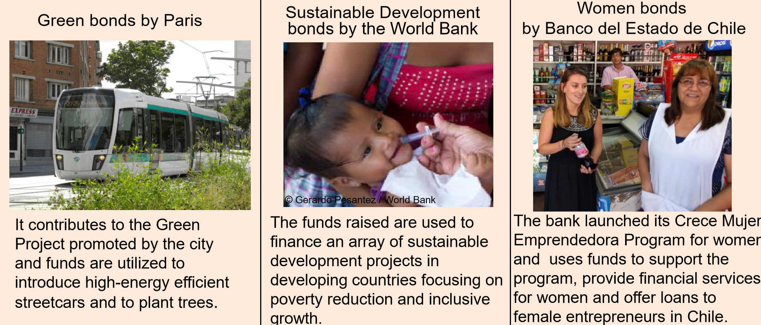
14
Nippon Life’s ESG Investments
Investment in green bonds and other ESG bonds fits in with the fund management philosophy of the life insurance business, which is highly social and public
Cumulative investment is approximately 170 billion yen ($1.4 billion)
Signed the PRI (Principles for Responsible Investment) and set a quantitative target for investment of JPY 200 billion
（Source – Nippon Life Insurance Company)
Notes:
14

Slide 15


15
Some words from Taoism - yin and yang
Have a holistic vision
Be aware that the world is cyclical
Don’t go to the extreme, otherwise you will fall
  Bring the balance of yin and yang to the universe
In order to manage the world, you should control yourself
  In order to implement international standards, you should first know your own country
（Photo – Tao Garden, Chang Mai, Thailand)
Notes:
15

Slide 16
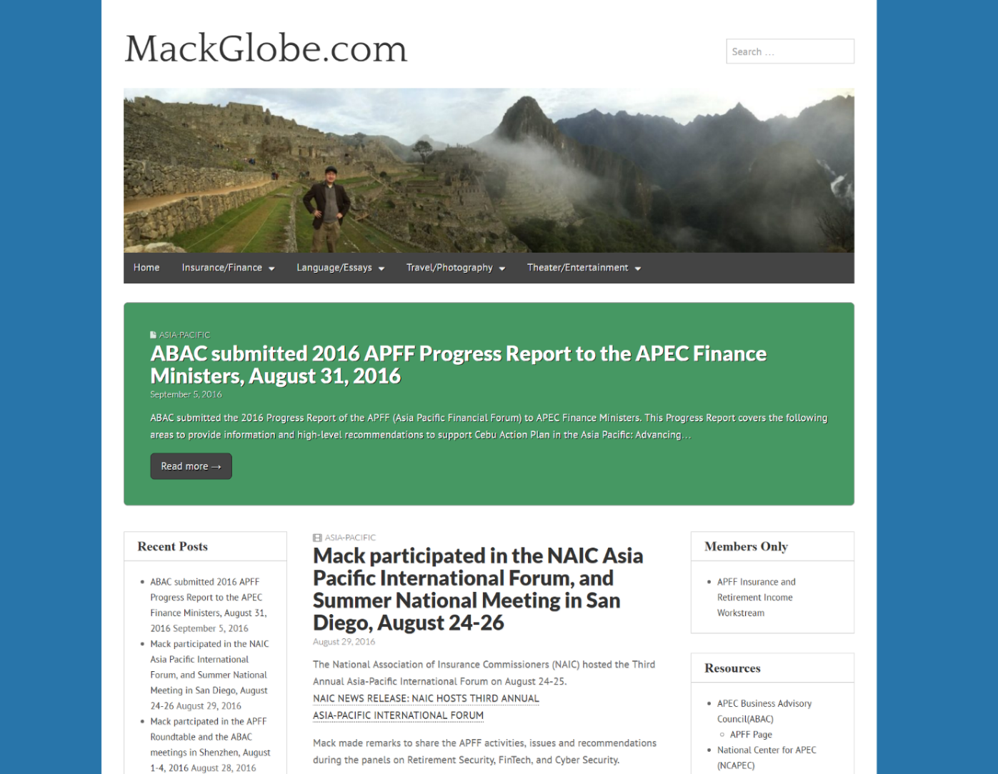
Asia Pacific Financial Forum (APFF)
Insurers’ Long-Term Investments to Support Sustainable Growth and Development
  For more details on the APFF, visit mackglobe.com or email
  Makoto Okubo (m-okubo@nipponlifeglobal.com)
Notes:
16

