Slide 1
TAO OF GLOBAL COMMUNICATION AND BUSINESS
How does our language affect the way we think and communicate?
What can we learn from Japanese and other Asians?
To go beyond our culture and nationalities…
Nippon Life Special Seminar
For World Bachelor in Business (WBB) program, Hong Kong University of Science and Technology (HKUST)
Tokyo, January 29, 2018
Makoto Okubo (MACK)

Slide 2
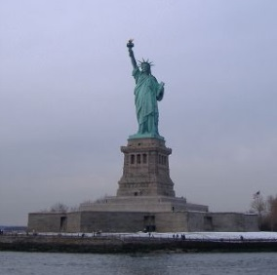
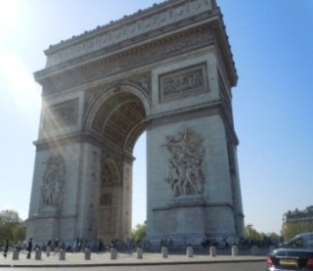
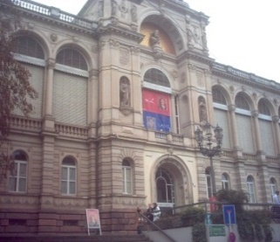
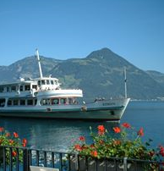
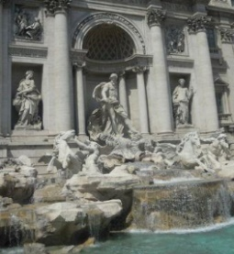


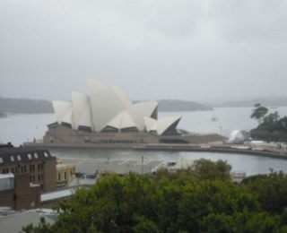




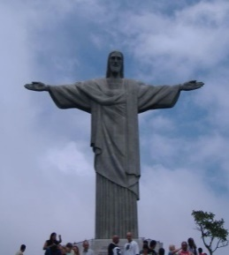

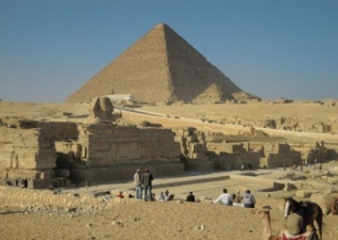


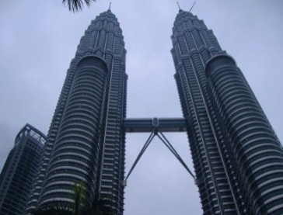

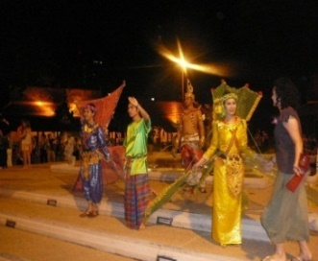
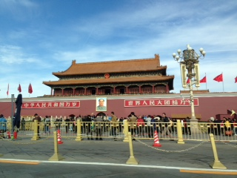

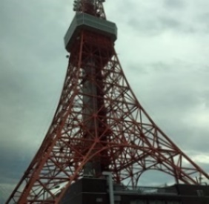

English in the world
(United States)
(France)
(Germany)
(Switzerland）
(Italy)
(United Kingdom)
(Coming to America 1988)
(Australia)
(New Zealand)
(Canada)
(Mexico)
(Chile)
(Brazil)
(Kenya)
(Egypt)
(Russia)
(Singapore)
(Malaysia)
(Philippines)
(Thailand)
(China)
(Korea)
(Japan)
(India)
Notes:
2

Slide 3
Contents
Part I
Just-in-time system of communication
Release from your language
Part II
Release from fixed ideas – A Zen exercise
Yin and Yang – From ancient China
Notion of existence – From ancient India
P.S.
Principles to make your dreams come true

Slide 4
1. Just-in-time system of communication
I want to go to America.
  (cf Ｄ＝Ａ×Ｂ＋Ｃ)
Je veux aller en France. I want go to France
(Yo) Quiero ir a España. (I) want go to Spain
Ich möchte nach Deutschland fliegen. I want to Germany fly
我要去中國 I want go China
私は日本に行きたい I Japan to go want
  (ｃｆ ＤＡＢ×Ｃ＋＝)
  Inverse Polish Notation
Westerners run after thinking
Japanese walk while thinking
I got it! This way!
I wonder where it is..
Notes:
4

Slide 5

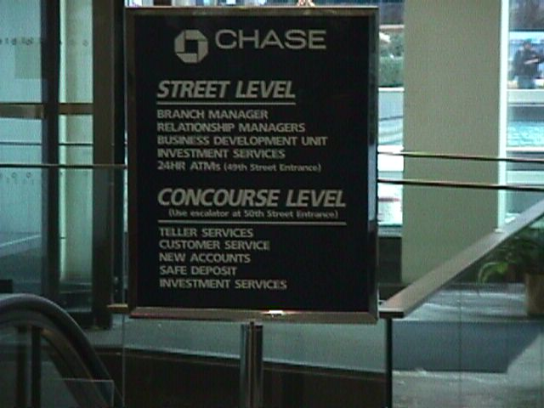
1. Just-in-time system of communication
Making presentations
  Different concentration patterns for US and Japanese audience
  How to structure your speech?
Two advantage of Japanese language toward consensus
  Why is it harder to work in a group in English?
Choice of English or Japanese styles by your needs
  Because or therefore?
  Convey information or negotiate with others?
(Photo – New York, United States)
Notes:
5

Slide 6
2. Release from your language
（1） Limitation of language
Why do you wish to learn Japanese even if you never go to Japan in your life?
Keywords for successful business? Limited vocabulary
Different scope (that and it, on and above, come and go)
False friends (public companies)
Fureai?
Yoroshiku?
Japanese
English
Chinese
Notes:
6

Slide 7


2. Release from your language
（2） Brain and language
What part of your brain are you using to read?
  English
    Fish, Tree, Forest
  Chinese
    魚、木、森
  Japanese
    森で木をきり、魚つりをしました
How would this affect the way you think?
Notes:
7

Slide 8
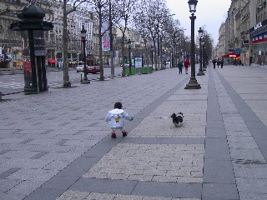
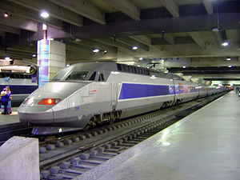
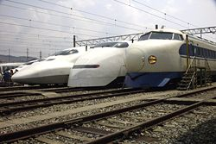
2. Release from your language
（3） Value, culture and vocabulary
Which is more adult, Japanese or French?
  Reasons for which they viewed each other childish
Which is faster, TGV or Shinkansen (Japanese Bullet Train) ?
  TGV uses motors only at the front
  Shinkansen has motors under each carriage, coordinated by the front
  Different leadership models in France and Japan
The meaning of words, as well as the choice of terms may be different to different people
(Photo – Paris, France)
(Source - Wikipedia)

Slide 9
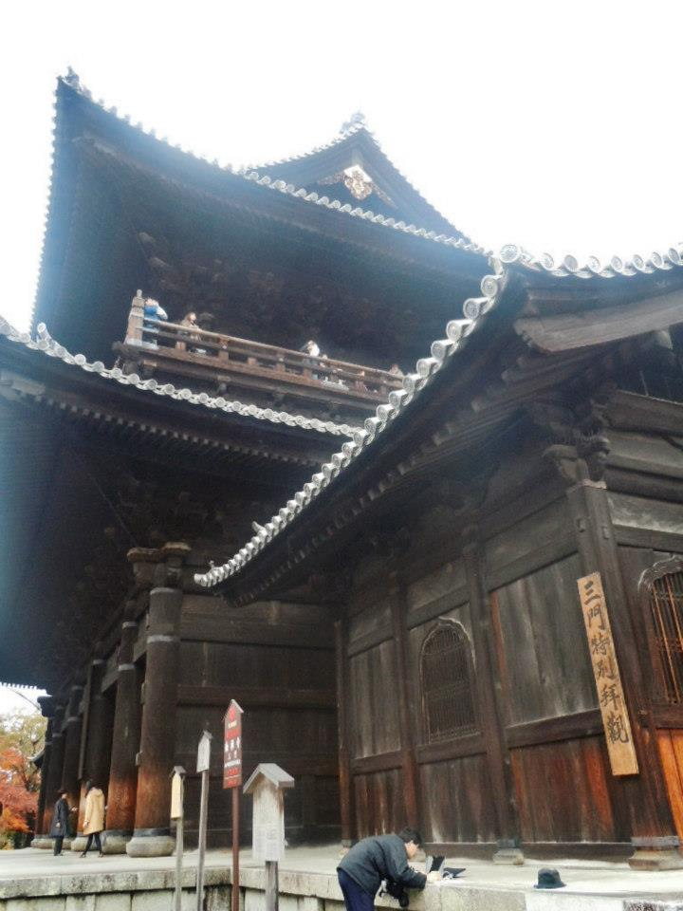

3. Release from fixed ideas – A Zen exercise
How to move yourself away from the stereotypes
Zen riddle
  The art of jump and association
Two types of creativity
  Give birth to things that have never existed
  Associate things that have nothing to do with
Relationship between creativity and consensus
  “Experience” tied with the past
  Start from apparently not feasible plans
(Photo – Kyoto, Japan)
Notes:
9

Slide 10
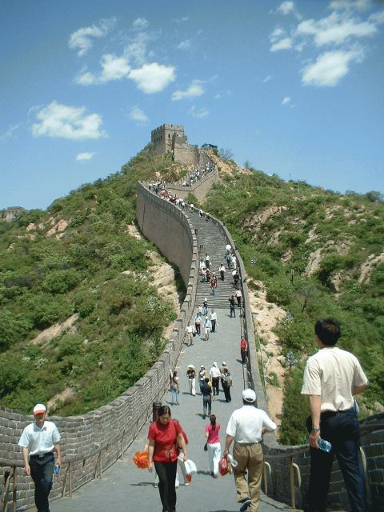

4. Yin and Yang - From Ancient China
(1) Dualism of Yin (陰) and Yang (陽)
Exclusive dualism (Western style)
  Good vs. Bad
  Positive vs. Negative
  Rational vs. Irrational
Complementary dualism (Oriental style)
  Strong ∽ Weak
  Inside ∽ Outside
  Rational ∽ Intuitive
(Photo - The Great Wall, China)
Notes:
10

Slide 11
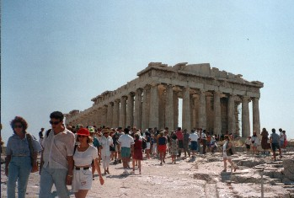

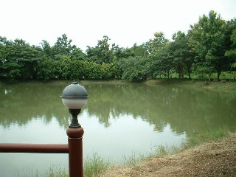

4. Yin and Yang - From Ancient China
(2) Greek philosophy and Taoism
Go straight to your goal? (Western style)
Go around? (Art of non-action) (Oriental style)
(Photo – Athens, Greece)
(Photo – Tao Garden, Chiang-Mai, Thailand)
Notes:
11

Slide 12
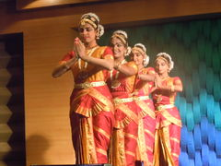

5. Notion of existence - From Ancient India
Western style
  Define its existence a priori either as material or spirit
Oriental style
  Define its existence a posteriori by its relationship with the world (cf. Quantum theory)
  Conception of emptiness
    “Exist” and “Do Not Exist” are equal two poles
(Photo – Hyderabad, India)
Notes:
12

Slide 13
Principles to make your dreams come true
Take a chance You can’t steal second base and keep your foot on first. (by Frederich)
Take actions and responsibility It’s not what you can do but what you really do that matters. (by a movie director for Veronica Ferres）
Look forward Don’t regret but reflect the past.
Serendipity You can't connect the dots looking forward; you can only connect them looking backwards. So you have to trust that the dots will somehow connect in your future. (by Steve Jobs)
Trust yourself and don’t give up If you walk toward a castle on the hill and lose the sight, it means you are almost there.
Think Global Act Local (by a number of global players)
Bring a balance of yin and yang (by the Taoists)
Contraria sunt complementa (by Niels Bohr)
Notes:
13

Slide 14
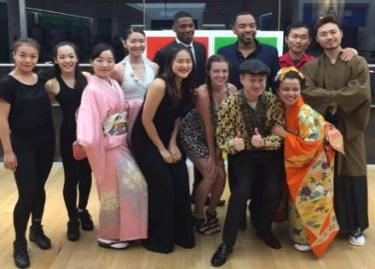
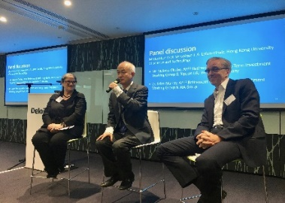
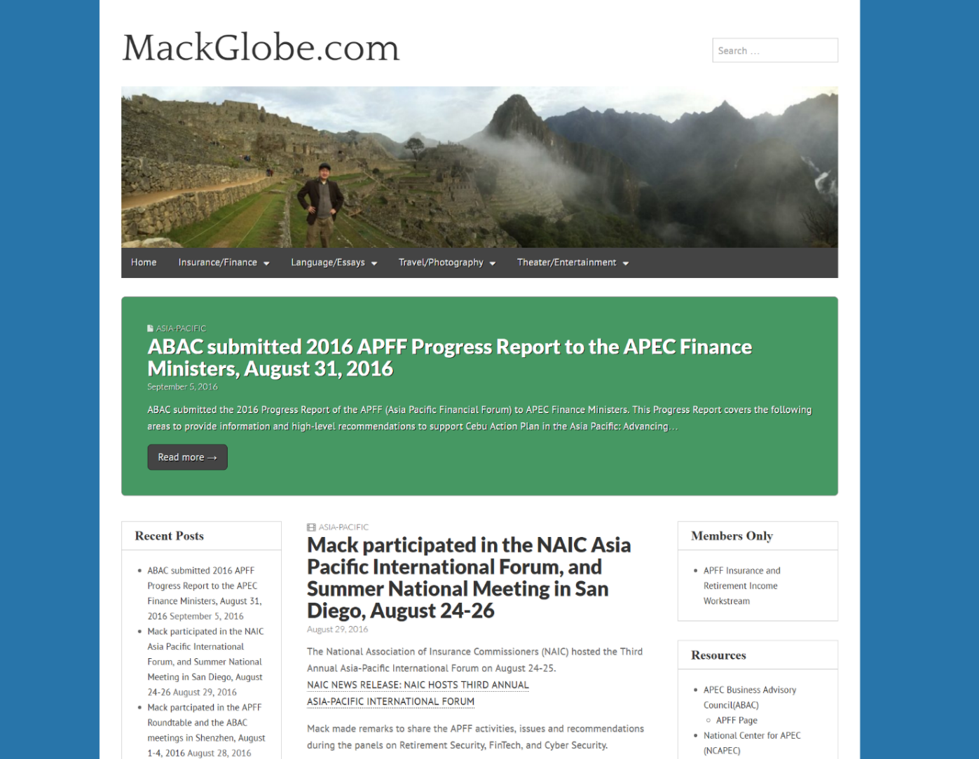

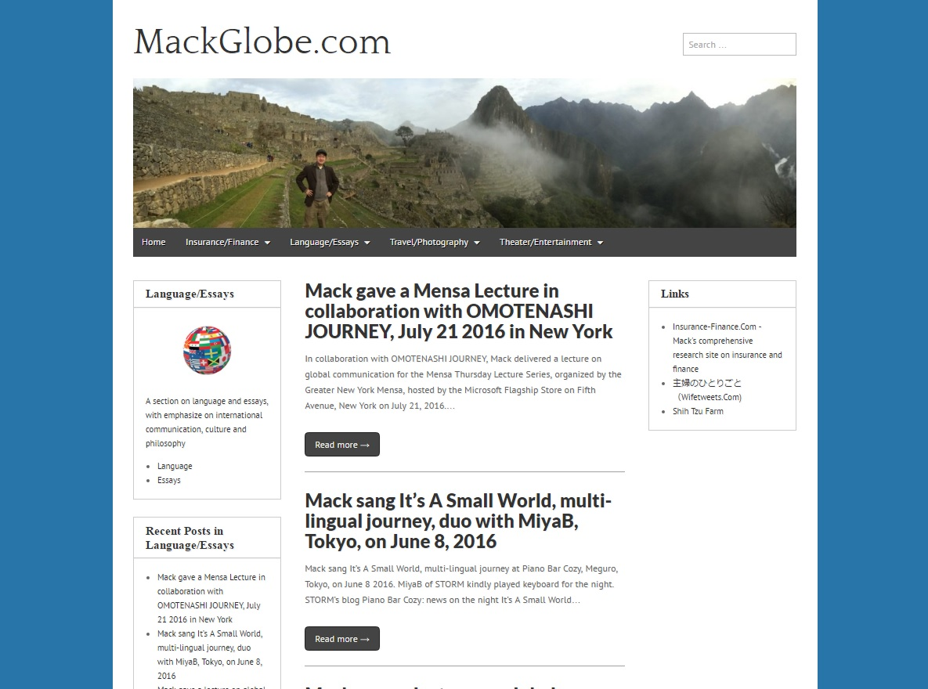

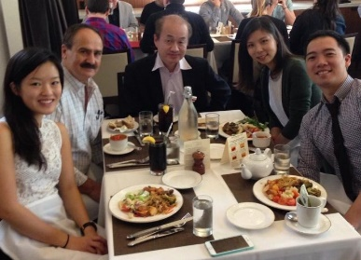

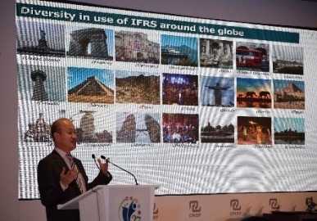

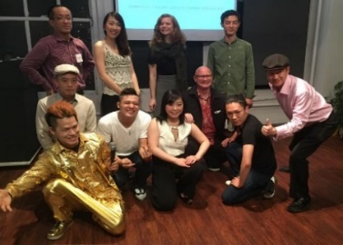
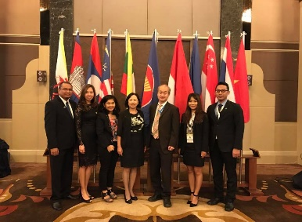
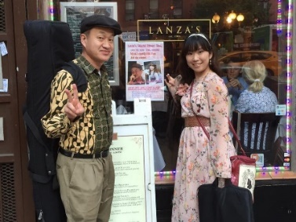

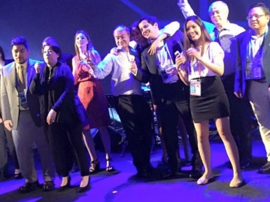

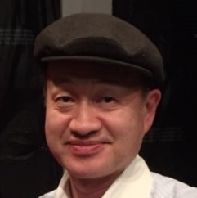

TAO OF GLOBAL COMMUNICATION AND BUSINESS By Makoto Okubo
  Any questions? email me to mackglobe@gmail.com
  or visit www.mackglobe.com

